Slide 1
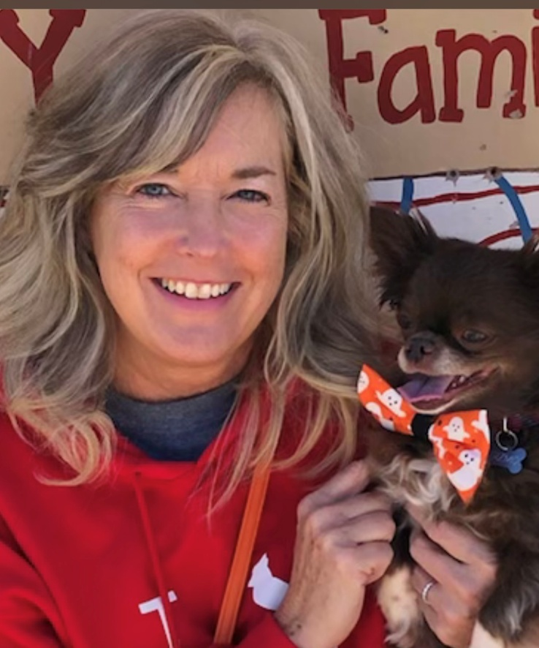
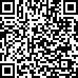
Welcome to the PK Inclusion classroom 2025-2026! I am so happy to be your teacher this school year! This year will be full of learning, growing and fun!
My name is Ms. Kerry and I have been teaching for 36 years. I am originally from West Virginia. When I am not teaching, I love to spend time with my husband and family. I enjoy shopping and being a Dog Mom.
Chocolate
Reese’s Pieces
Candles
Diet Coke
Target
Michael’s
Amazon
Please feel free to contact me with any questions! ClassDojo is typically the best way to contact me.
Email: kerry.filben@slps.org
ClassDojo Message
Donate an item to our class wish list!

